Slide 1
Accessing the curriculum for diverse learners
Literacy Development

Slide 2
Continuum of Literacy Instruction
Emergent Literacy
Learning about print and sound
Early Literacy
Learning to read
Conventional Literacy
Reading to learn / comprehension

Slide 3

Components of Reading
Code Related Reading Process: reader’s ability to understand the structure of print
Meaning Related Reading Process: refers to global understanding of printed words and sentences

Slide 4
Learning to To Read
Code related reading process
Phonological awareness
Alphabet knowledge
Meaning based reading process
Listening comprehension
Vocabulary
Print concepts
Emergent writing
Grammatical understanding
Background knowledge
Text structures: narrative, informational

Slide 5
Literacy Development
Emergent Literacy
Joint attention, interaction
turn taking, print concepts
Early Literacy
Literacy partner guiding reading
Written symbols have meaning
Conventional Literacy
Independence when interacting with text
Reading for different purposes

Slide 6
Learning to read
Reading is complex
Supporting a student to learn to read means working on multiple areas
Balanced Literacy: focus on interests with both code related and meaning making skills
Improvements in one area don’t cross over to the other areas (only working on sight words or decoding will not improve comprehension skills)
It doesn’t matter what age a student is at – it matters what stage of literacy development s/he is at!

Slide 7
Inclusive Literacy Development
Literacy development for all
1.
2.
3.
4.
5.
Paraphrase each of the 5 points and insert into web boxes
For each point give at least 2 specific ways an education assistant can contribute to this principle

Slide 8
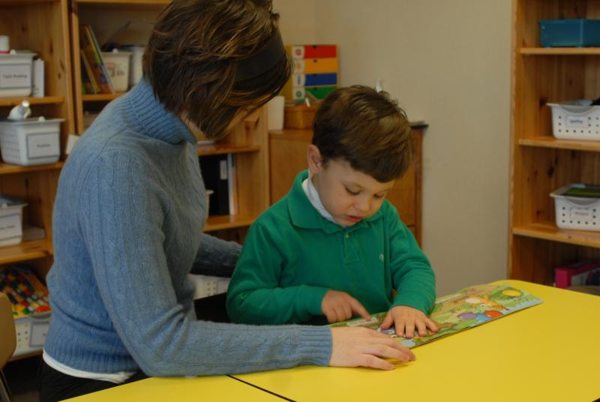
Instructional Challenges
Differences in life experience and background knowledge
Social communication differences
Differences in cognitive processing and learning style

Slide 9

Instructional Challenges
Cognitive Processing
Slow speed of information processing
Small short-term memory
Narrower focus of general knowledge
Difficulties with language
Poor attention skills
Distracted by other stimuli
Difficulties with generalization and problem solving

Slide 10
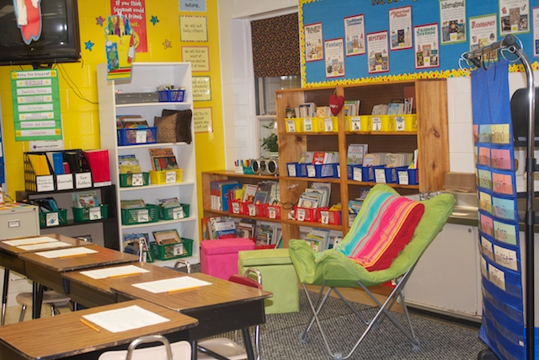
At the classroom level
Print in the environment
Opportunities for reading and writing
Adapted books
Visual supports
Balanced literacy experiences
Interactive instructional strategies for book reading
Direct instruction

Slide 11

At the individual level
Knowledgeable educators
Student has a means of communication / interaction
Repetition with variety
Cognitive engagement / active participation
Cognitive clarity
Personal connection with the curriculum

Slide 12
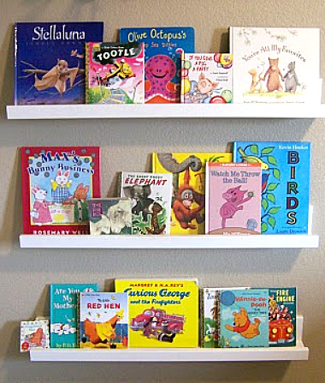
Books for Students
Choosing books for individual students
Adapting books to support active engagement and participation
Reading the book interactively (reading to and with students)

Slide 13

Choosing Books
Student’s literacy level
Purpose of reading the book (what are you trying to achieve?)

Slide 14
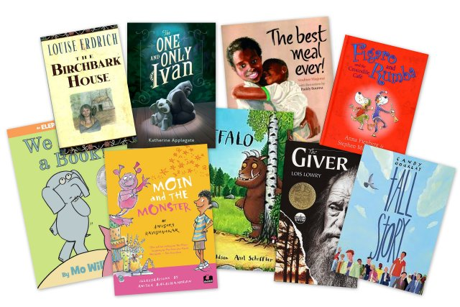
Choosing Books
Children’s literature
Picture books (all ages)
Chapter books
Novels
Leveled books
Designed to teach how to read
Non – fiction
Customized books

Slide 15

Making Decisions About Books
Are the KEY FEATURES appropriate for the student’s literacy stage and IEP goals?
Are their elements that will support ENGAGEMENT and ACTIVE PARTICIPATION?
Is this TOPIC OF INTEREST or does it CONNECT TO THE CURRICULUM?
REMEMBER: with older students books must be age-respectful / age appropriate

Slide 16

Selecting Books
Content
Length of book
Topic – familiar or not
Vocabulary and concepts
Degree of predictability
Sentences
Simple? Complex? Statements? Questions?
Words within Sentences
How many words
How many are repeated

Slide 17

Selecting Books
Graphics
Match between picture and print
Print
Size of print
Placement
How many lines of print per page

Slide 18

Books for …
Reading aloud to students
Teaching students how to read
Students to read together with you
Students to read independently
Recreational reading vs. books for school learning

Slide 19
Different Books for Different Purposes
Reading to Students
At or slightly above their comprehension
Interactive Read Alouds
Reading with Students
Supported book reading for active participation and interaction
Leveled books for teaching students to read; books at their instructional level
Reading by Students
At their independent reading level
Reading for practice and fluency
Modeling language and strategies
Teaching skills and strategies

Slide 20
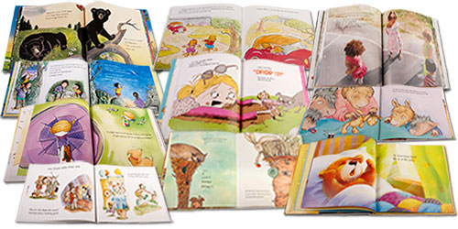
Let’s Take a Picture Walk

Slide 21

Let’s Take a Picture Walk

Slide 22
Your picture books - analysis
Picture Walk
Book Selection
What did you learn about the book through this process?
What did you learn about introducing a book this way?
What do you need to develop in yourself to use this strategy?
Content
Sentences
Words within Sentences
Graphics
Print
How do you think this choice would work with a student learning to read?

